Slide 1



About me
AISHWARYA HOYSAL K S
👉Microsoft Certified Azure AI Fundamentals
👉ML intern @ Rosette Smart Life
👉Enthusiast in AI / ML, Gen AI , LLMs and Data science
👉Python Developer , Proficient in SQL, Power BI

Slide 2
Overview
What is NLP ?
Importance of NLP in industry
State of NLP in current technology
Learning techniques in NLP model
Transformer architecture
Ethical Considerations
Future Applications

Slide 3



Slide 4
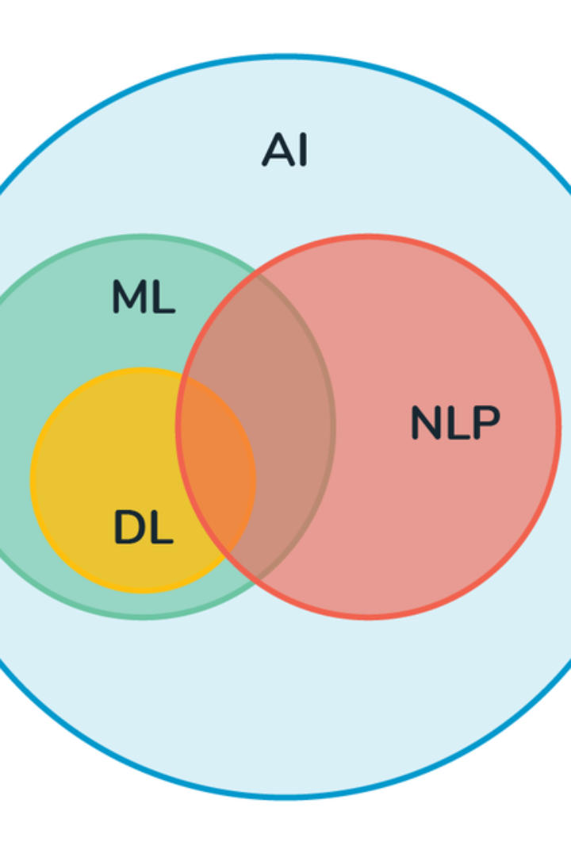
Future Trends in NLP
Natural Language Processing (NLP) is a branch of artificial intelligence that focuses on the interaction between computers and humans through natural language. It involves the development of algorithms that allow computers to understand, interpret, and respond to human language.

Slide 5

What is NLP?
NLP involves the application of computational techniques to analyze, understand, and derive meaning from human language in an intelligent and useful manner.
It encompasses various components such as text analysis, speech recognition, language generation, and machine translation.
NLP finds applications in chatbots, sentiment analysis, language translation, and information extraction, among others.

Slide 6
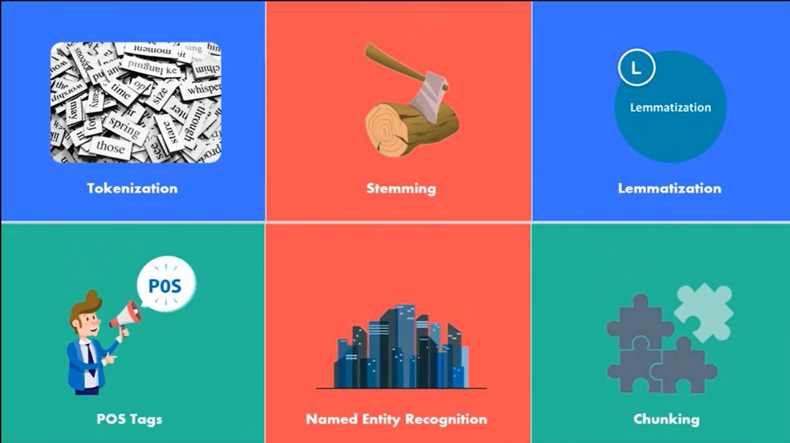

Slide 7

NLP's Importance in Industry
Enhanced Customer Experiences
Data Analysis
Efficient Communication
NLP helps in extracting valuable insights from unstructured data, facilitating informed decision-making in industries like finance and healthcare.
It enables the automation of routine communications, streamlining internal processes and enhancing productivity.
NLP powers virtual assistants and chatbots, enabling businesses to provide timely and personalized customer support.

Slide 8

Current state of NLP technology
Continual Advancements
Industry Adoption
NLP technology is dominated by transformer-based models like GPT-3, BERT, and T5, showcasing remarkable natural language understanding and generation. These models excel in diverse tasks, from text summarization to language translation.
Several industries are integrating NLP into their operations, harnessing its capabilities to gain a competitive edge and drive innovation.

Slide 9
Zero shot learning and few shot learning
1
Zero Shot Learning
Zero shot learning enables models to perform a task without receiving specific training examples, expanding the scope of NLP applications.
2
Few Shot Learning
With few shot learning, models are trained on a minimal number of examples, enhancing their ability to generalize and learn from small datasets.

Slide 10

Zero shot learning

Slide 11


Slide 12

Few shot learning

Slide 13
Transfer Learning
Transfer Learning
Impact and Benefits
Transfer learning leverages pre-trained language models to improve performance on specific NLP tasks, reducing the need for extensive task-specific training datasets.
It accelerates the development of NLP models, enables faster deployment, and facilitates knowledge transfer between tasks and domains.
Applications
Transfer learning is being employed in sentiment analysis, text classification, and language modeling with promising results.

Slide 14

Multi-lingual Learning
Language Understanding
Breaking Language Barriers
Multilingual learning enables computers to understand and work with text in multiple languages. This means that technology becomes more inclusive, catering to people who speak different languages around the world.
we can break down language barriers in communication. Computers learn to process and generate content in various languages, fostering better global collaboration and understanding. It's like having a digital bridge that connects speakers of different languages.
Efficient communication tool
Translation services powered by these models make it easier for people who speak different languages to communicate seamlessly, whether it's for business, education, or personal interactions.

Slide 15

Transformer
architecture

Slide 16

Ethical considerations in NLP
Privacy Concerns
The use of NLP raises privacy issues related to data collection, user consent, and the ethical use of personal information.
Bias Mitigation
Ethical NLP involves addressing biases present in training data and model outputs to ensure fair and inclusive representation.
Transparency and Accountability
Ensuring transparency in NLP systems and holding organizations accountable for their use of language technologies are essential for ethical practices.

Slide 17
Future applications of NLP
Conversational AI in Customer Service
Improved NLP can enhance customer service by enabling more natural and effective interactions between users and chatbots or virtual agents.
Mental health support
NLP-powered chatbots or virtual agents could provide mental health support by engaging in conversations, understanding emotions, and offering relevant resources or interventions.
Human Resources and Recruitment
NLP applications may play a role in automating aspects of the recruitment process, including resume screening, candidate matching, and even conducting initial virtual interviews.

Slide 18
Advanced Virtual assistant
Future virtual assistants could understand and respond to natural language in a more human-like manner, making interactions more intuitive and personalized.
Emotion Recognition
NLP could be integrated with other technologies to recognize and respond to human emotions, improving human-computer interaction in applications like gaming, virtual reality, and robotics.
Public safety and security
NLP could be employed in monitoring social media and other online platforms for early detection of potential security threats or public safety concerns.

Slide 19
The future trends in NLP reflect the ongoing advancements, challenges, and ethical considerations in this transformative field.
As NLP continues to expand its impact, understanding its evolving landscape is crucial for industry innovation and responsible deployment.

Slide 20


Slide 21


